Slide 1
Concept Representation Reflects Multimodal Abstraction: A Framework for Embodied Semantics
Leonardo Fernandino, Jeffrey R. Binder, Rutvik H. Desai, Suzanne L. Pendl, Colin J. Humphries, William L. Gross, Lisa L. Conant, and Mark S. Seidenberg
Presented by: Massimo Stefan

Slide 2
CONTENTS
Background
Questions
Hypotheses
Methods
Predictions
Results
Discussion
Conclusion

Slide 3
background
Perception → Comprehension
Embodied Semantics: language comprehension involves reactivating sensory-motor experiences from our interactions with the world
Sensory-Motor Cortical Areas: play a crucial role in forming and retrieving concepts related to objects and actions
🗒️ Note: even abstract concepts are understood through this framework 📝 Example: “grasping an idea”

Slide 4
background
Meaning ↔ Physical experiences and perception
Neuroimaging evidence: understanding language involves mental simulations of sensory and motor experiences 🧪 Proof: activation in corresponding brain areas during language processing
Multimodal integration: beyond single sensory-motor domains, certain brain areas integrate multiple sensory and motor experiences, reflecting a more complex aspect of conceptual knowledge.

Slide 5
questions
Big theoretical question: To what extent do sensory and motor cortical areas contribute to the neural representation of concepts, and how are these representations influenced by our sensory-motor experiences?
Experimental question: How do various sensory-motor attributes (such as color, shape, manipulation, sound, visual motion) influence the semantic processing of words in the brain?

Slide 6



HYPOTHESES
H1 (Experimental Hypothesis): Different sensory-motor attributes of words activate distinct and specific brain regions associated with the processing of those attributes during
H2 (Alternative Hypothesis): The brain represents sensory-motor attributes of words in an amodal (non-sensory-specific) manner → representation is not tied to the specific sensory or motor system
H0 (Null hypothesis): Sensory-motor attributes of words do NOT significantly activate specific brain regions or networks → these attributes are not distinctively represented during word processing

Slide 7
Methods: overview
Stimuli
Participants
900 words
600 relatively concrete
300 relatively abstract
Various semantic categories
NOT distributed equally across sensory-motor domains
All familiar
300 pseudowords (word-like nonwords)
760 passive fixation events (act as baseline and provide jittering for the deconvolution analysis)
44 healty, native speakers of English
Mean age: 28,2
No history of neurological or psychiatric disorders
Attributes
Color, shape, manipulation, sound, and visual motion (closely tied to sensory-motor experience)
Rating of the relevance to the meaning of each word obtained from 342 participants on a 7-point scale (from “not at all relevant” to “very relevant”)

Slide 8
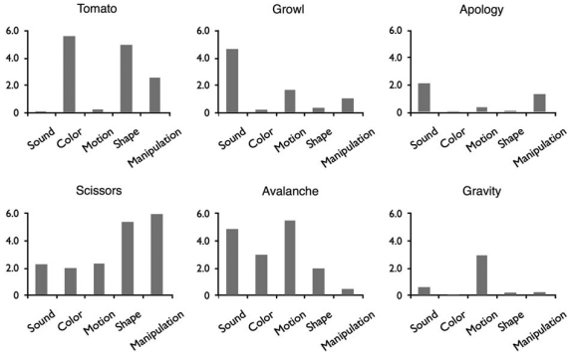
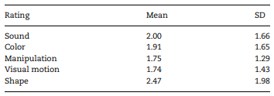
Methods: overview
⚠️ NOT all attributes correspond directly to a modality
Shape → visual and somatosensory
Manipulation → motor, visual and somatosensory
✅ All attributes are associated with well-studied cortical regions

Slide 9
Methods: details
🔣 Presentation of words: Participants were exposed to the stimuluts during a fMRI scanning in 10 different runs
🗒️ Participant task: Participants were required to decide whether the stimulus was:
A word (yes)
A pseudoword (no)
🧠 Recording brain activity: The brain activity of participants was recorded as they were exposed to these words:
23 scanned on a GE 1.5T Signa MRI scanner
21 scanned on a GE 3-T Excite MRI scanner
⚙️ Data preprocessing:
The activity levels has been:
Aligned to the T₁-weighted anatomical volume
Transformed into standard space
Resampled at 3-mm isotropic voxels
Smoothed with a 6-mm FWHM Guassian kernel

Slide 10
Methods: details
⚙️ Data preprocessing:
The attribute relevance ratings has been:
Transformed to standard z-scores → how many standard deviations a value is above or below the mean 🎯 Goal: provide a way to compare attributes on a common scale
Coded separately between abstract and concrete words 🎯 Goal: ensure that only concrete words contribute to the attribute maps
Converted to ranks prior to entering the regression model 🎯 Goal: eliminate any differences in the distribution of the ratings by imposing a flat distribution to all of them
📊 Perform different analyses:
A Full-model analysis: included all five semantic attributes in a single regression model 🎯 Goal: identify voxels where activity correlated with a given attribute
5 leave-one-out analyses: performed by excluding 1 of the attributes from the regression model 🎯 Goal: identify activations driven by variance shared between 2 correlated attributes
5 single-attribute analyses: separate analyses conducted for each attribute alone, combined to create a conjunction map 🎯 Goal: identify regions modulated by all 5 attributes and exclusively 2,3 or 4 attributes
A Principal Component Analysis (PCA): on the attribute ratings to explore how their co-occurrence patterns

Slide 11
HYPOTHESES: review
H1 (Experimental Hypothesis): Different sensory-motor attributes of words activate distinct and specific brain regions associated with the processing of those attributes during
H2 (Alternative Hypothesis): The brain represents sensory-motor attributes of words in an amodal (non-sensory-specific) manner → representation is not tied to the specific sensory or motor system
H0 (Null hypothesis): Sensory-motor attributes of words do NOT significantly activate specific brain regions or networks → these attributes are not distinctively represented during word processing

Slide 12
predictions
If H1 was true: The fMRI data would reveal distinct brain regions correlating with each of the sensory-motor attributes 📝 Example: words with high relevance of ‘color’ should predominantly activate visual areas known for color processing
If H2 was true: The activation patternswould not be confined to specific sensory or motor regions, but we would see a more diffuse activation (potentially in areas associated with higher-order processing) 📝 Example: words with high relevance of ‘color’ should activate the amodal network
If H0 was true: No significant correlation between the sensory-motor attributes of words and activation in any specific brain regions 📝 Example: words with high relevance of ‘color’ would not show specific patterns of activity in the brain

Slide 13
results
Participants successfully engaged in the semantic decision task, indicating close attention with mean accuracies
0.84 for words
0.96 for pseudowords
The fMRI data revealed that cortical areas modulated by semantic attributes included:
Uni-modal regions
Bi-modal regions
Multi-modal regions
with strong left-lateralization across all attributes

Slide 14
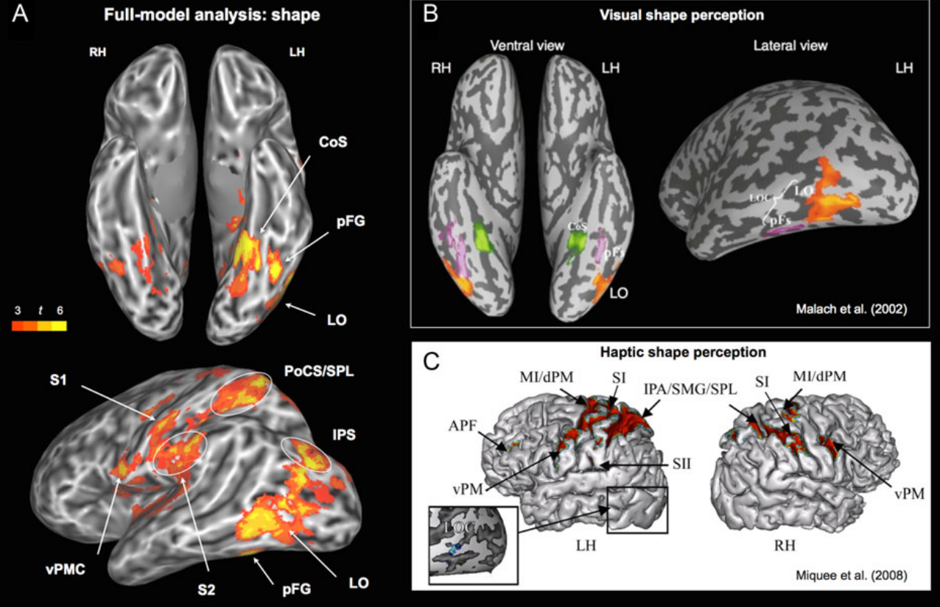
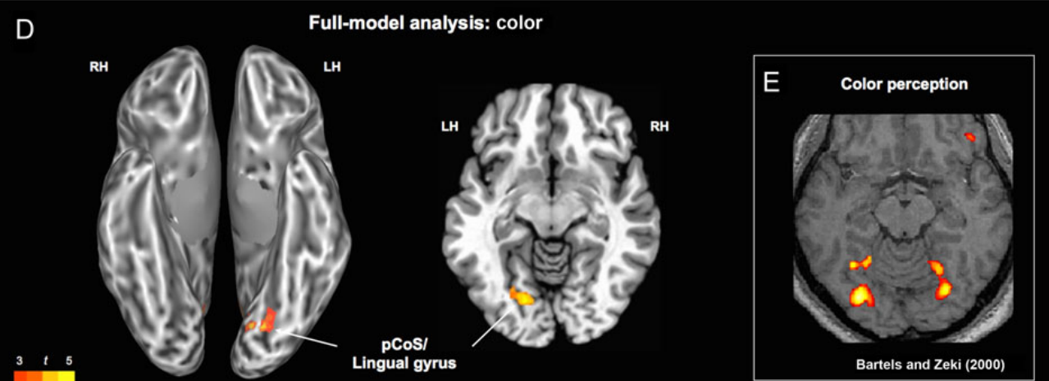
results
The Shape attribute modulated activity:
In the ventral stream areas involved in visual shape analysis: Ventral Occipitotemporal (VOT) and Lateral Occipital Complex (LOC)
In the Superior Occipital Gyrus and Posterior Intraparietal Sulcus (IPS), associated with object recognition over faces or scenes
In regions processing haptic and visuo-tactile information
✅ Supports H1
The Color attribute modulated activity:
In the left ventromedial occipital cortex, a part of the ventral visual pathway implicated in color perception
✅ Supports H1

Slide 15
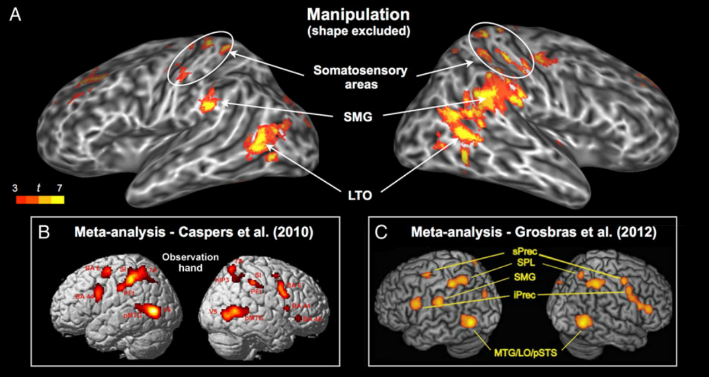
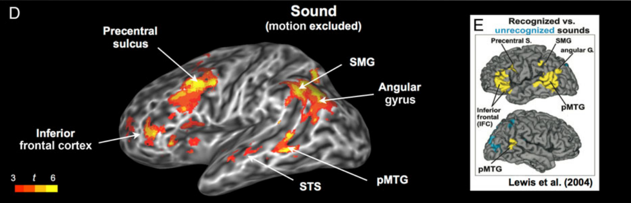
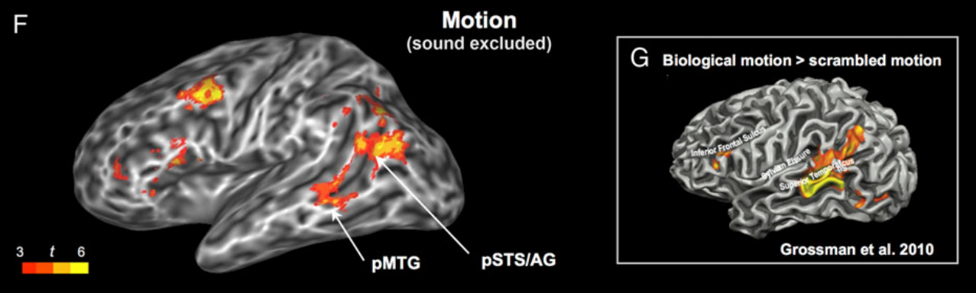
results
The Manipulation attribute modulated activity:
In areas involved in the action representation network, particularly responsive to object-directed hand actions
Left posterior middle temporal gyrus (pMTG)
Anterior occipital cortex
✅ Supports H1
The Sound attribute modulated activity:
In the left ventrolateral prefrontal cortex (VLPFC), a region implicated in nonspatial auditory processing
✅ Supports H1
The Visual motion attribute modulated activity:
NOT in area MT+, typically associated with visual motion
In the ventrolateral portion of the left angular gyrus
❌ Support H2, suggesting amodal processing

Slide 16
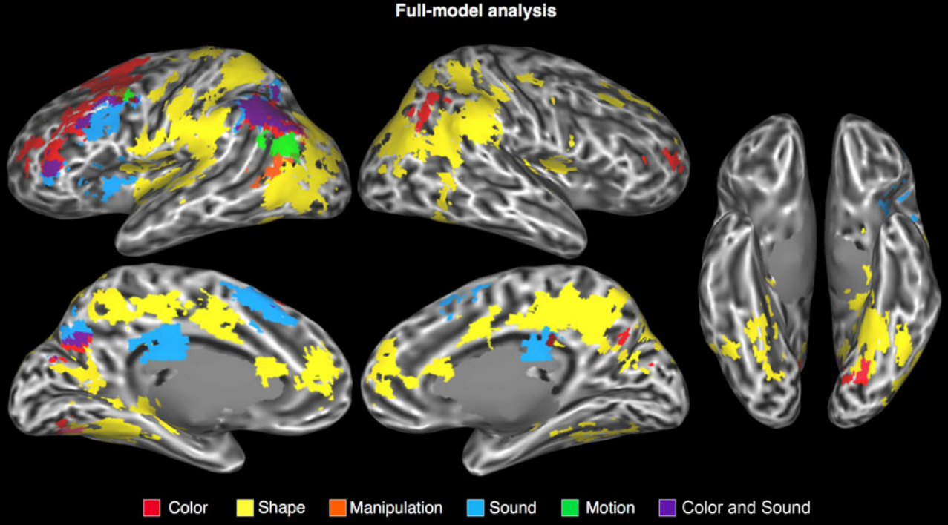
results
Results suggests that H1 is largely supported, as distinct brain regions correlated with sensory-motor attributes were identified, which are involved in processing those specific types of information during word processing.
The finding for visual motion might hint at a more complex representation that could lend some support to H2, but it does not fit the expected pattern for an amodal representation.

Slide 17
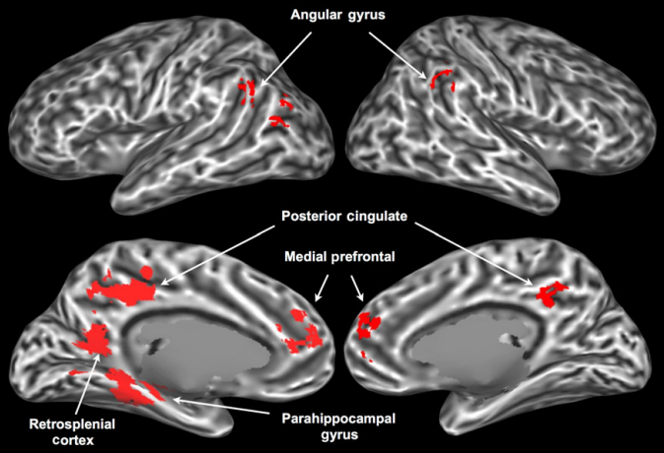
results
The areas activated by all 5 attributes were:
Parahippocampal Gyrus and Retrosplenial Cortex: linked to tasks that involve coordination of multiple representations 📝 Example: scene recognition and spatial navigation
Medial Prefrontal Cortex, posterior cingulate/precuneus, and angular gyrus: top-level convergence zones (CZs) for sensory-motor processing and are nodes of the “default-mode” network associated with conceptual processing
all implicated in high-level multimodal integration tasks
⚠️ Althouth the Anterior Temporal Lobes have been proposed to be a major hub for integrating conceptual information, was not activated by any of the 5 attributes (might be supramodal)

Slide 18
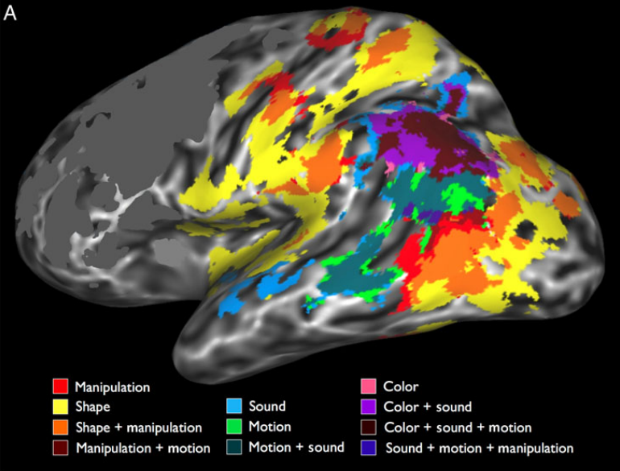
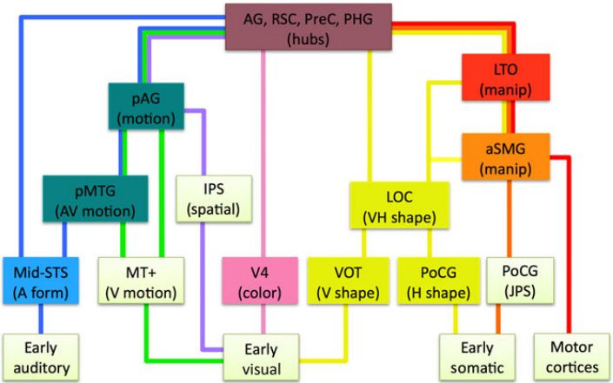
discussion
Findings:
The cortical regions where activity was modulated by sensory-motor attributes of word meaning consisted mostly of secondary sensory areas and multimodal integration areas
The results suggest a hierarchical system of sensory and motor pathways with conceptual attributes represented in specific multimodal subnetworks
Theoretical implications:
Contrary to the Hub and Spokes Model (Patterson et al. 2007), which posits a single amodal hub in the temporal pole, the study suggests multiple multimodal integration areas are involved in concept representation.
🗒️ Note: information flows mainly from low-level modal cortical areas toward multimodal areas and cortical hubs

Slide 19
conclusions
Word meanings are neurally encoded in a manner consistent with embodied semantics
4/5 semantic attributes related to distinct sensory-motor experiences correlate with activations in their respective sensory-motor regions
There is involvement of both early unimodal areas and multimodal areas, depending on the attribute
The results suggests a complex, hierarchical integration of sensory-motor information within semantic memory

Slide 20
APPENDIX
Both the Concrete Words Analysis and the Rank-Based Analysis produced very similar results
✅ Indicate robustness in the findings
The PCA on the attribute ratings to explore how their co-occurrence patterns map onto the properties of natural ontological categories showed that:
The 1st component (57% variance) → concrete concepts ⚔️ abstract concepts
The 2nd component (23% variance) → objects ⚔️ events
The 3rd component (11% variance) → manipulable entities ⚔️ nonmanipulable entities
The 4th component (6% variance) → entities associated with motion but no sound ⚔️ entities associated with sound but no motion
The 5th component (3% variance) → concrete entities with no characteristic shape ⚔️ all the others
👎🏻 The structure reflects correlation patterns between the original attributes as they occur in the world

Slide 21
THANK YOU
Massimo Stefan

